Slide 1
USGS Groundwater monitoring in Mark Twain and VC Highlands, Storey County, Nevada
By Kip K. Allander (kalland@usgs.gov) & David W. Smith (dwsmith@usgs.gov)
Storey County Commissioners meeting,
August 2, 2016

Slide 2
Outline
What is groundwater and aquifers?
Overview of USGS Middle Carson River Monitoring
  Project with Carson Water Subconservancy District
  Mark Twain Estates Groundwater
Virginia City Highlands Groundwater Conditions
  Water-level declines

Slide 3
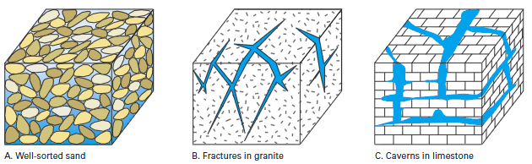
What is groundwater?
Liquid water in the subsurface.
Water occupies spaces between sand, silt, and gravel in fill; or fractures and cavities in rocks.
Water movement through and storage within the subsurface is governed by aquifer properties.
Permeability is ability of water to move through material.
Storage is amount of water stored in a given volume of aquifer.

Slide 4
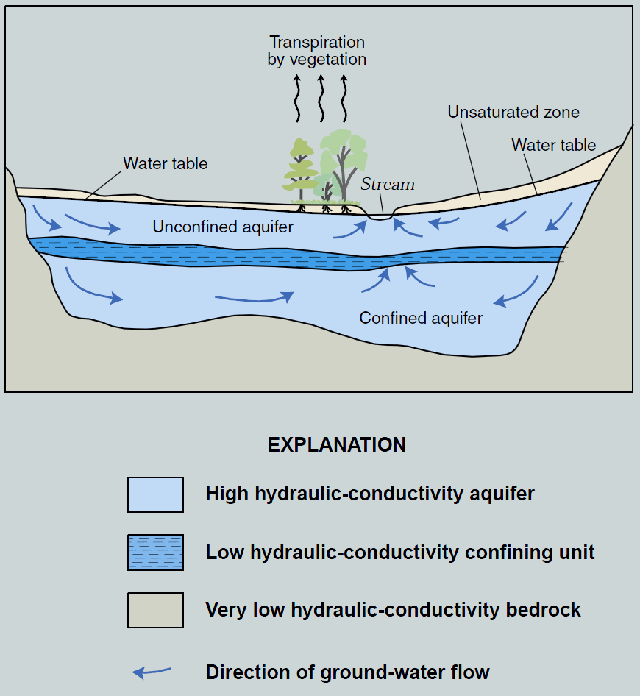
What is groundwater?
Groundwater flows from areas of recharge to areas of discharge.
Aquifers exist where groundwater can be developed to provide adequate supply to wells.
confining layer

Slide 5
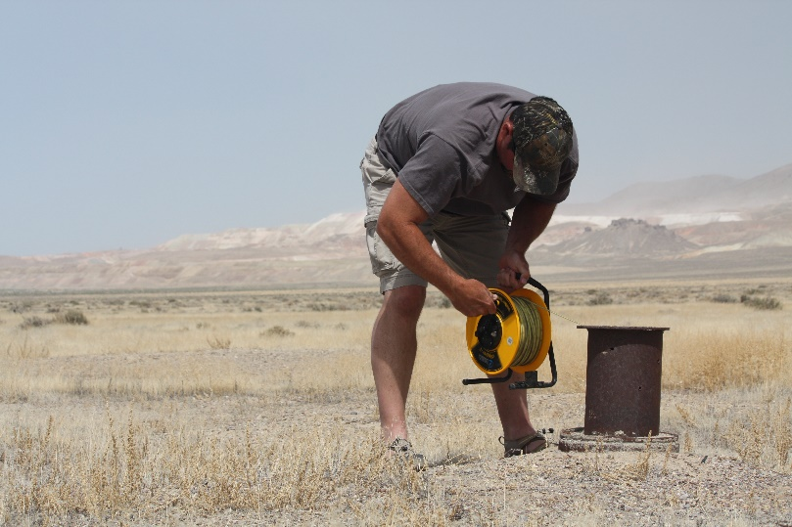
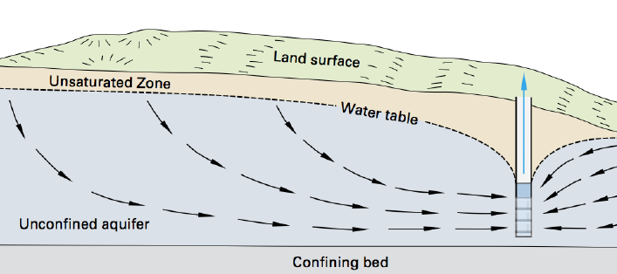
Change in groundwater levels are observed with water-level measurements

Slide 6
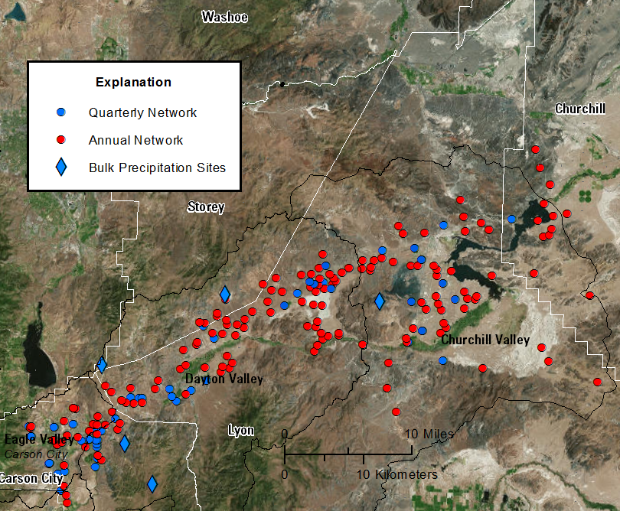
USGS Monitoring Network - Middle Carson
Mark Twain Estates
Cooperator: Carson Water Subconservancy District

Slide 7
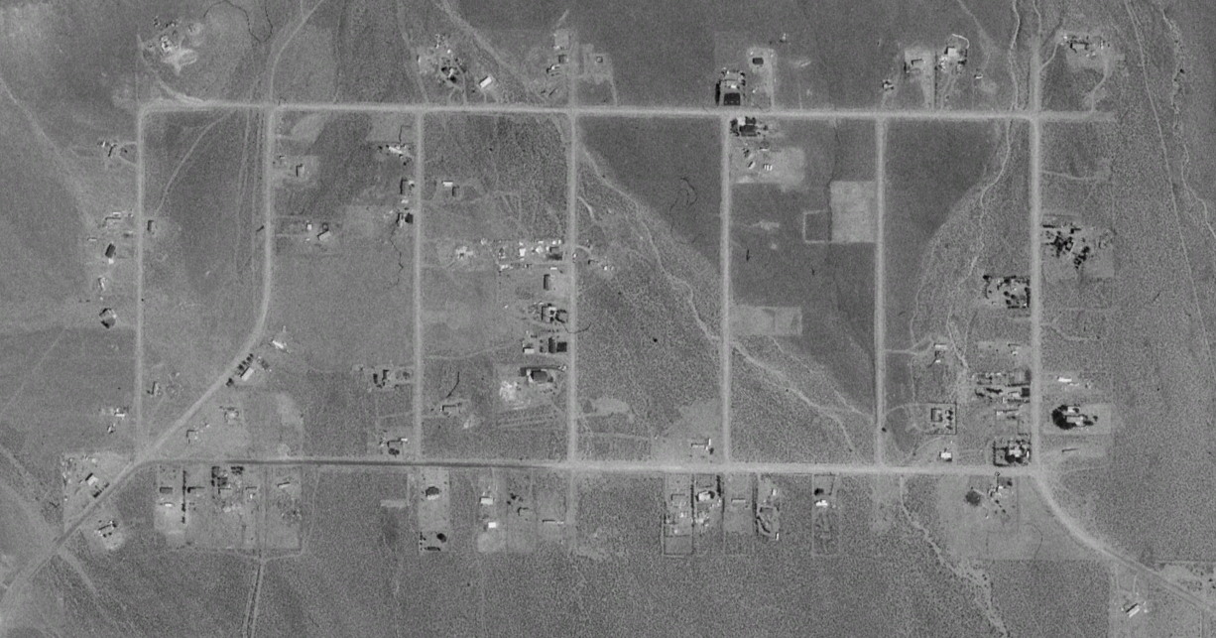
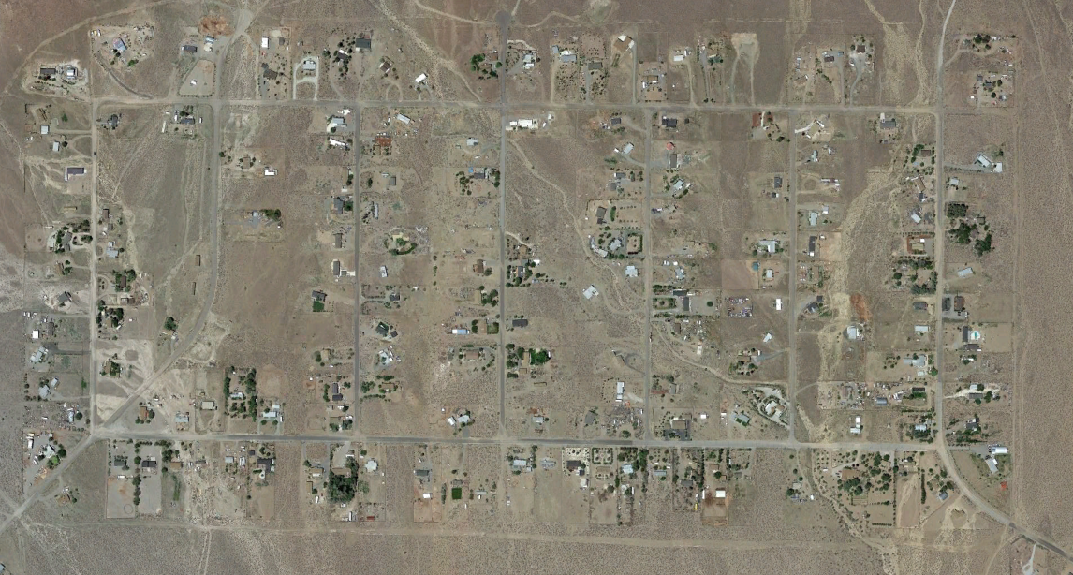
Mark Twain Estates Subdivision
“Water Woes of Mark Twain Estates”
  Article in the Virginia City News 11/20/2015
  5 domestic wells reported to have gone dry
  Potential Impact of lift stations from Dayton?
  Rumors of municipal well pumping cause 20ft of drawdown in the area.
June, 1990
June, 2015

Slide 8
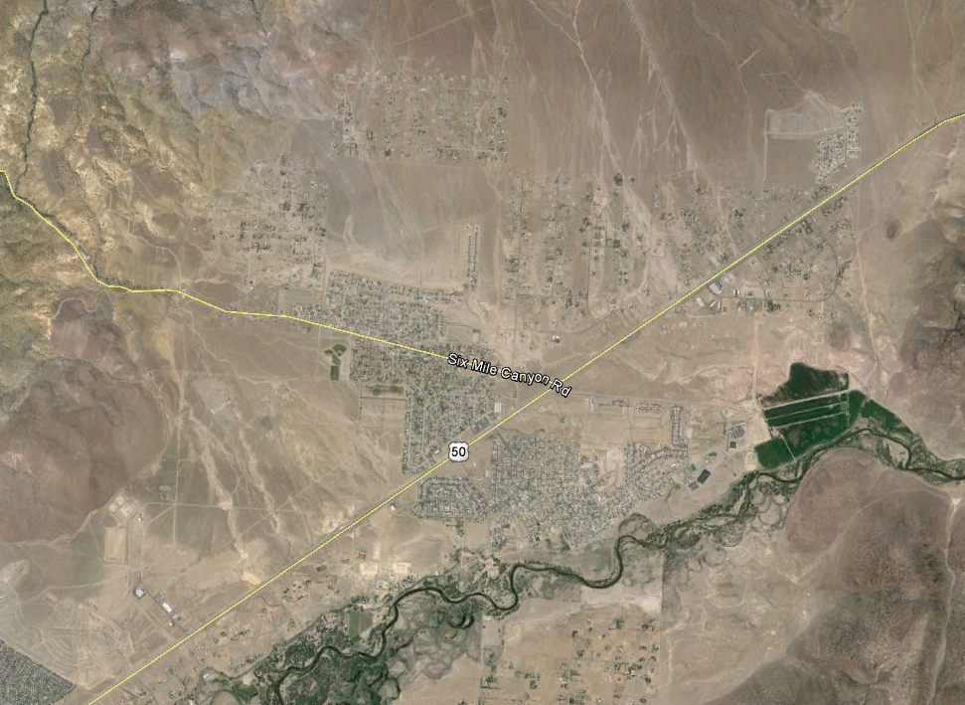
Mark Twain
Subdivision
Central Fire District
Mark Twain Community Center
Municipal wells turned off in 2012 due to elevated nitrate and TDS concentrations
USGS
Monitoring
Wells
Ring
Debris
Municipal
Wells
Notes:
Municipal wells are indicated by black dots
Monitoring wells are identified by colored dots

Slide 9
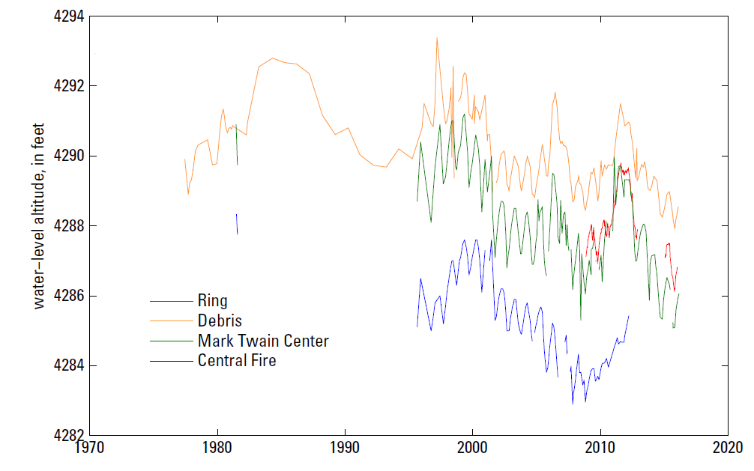
Water-level

Slide 10
159 Wells in section, and
only 4 wells have been
deepened.
Mark Twain
Subdivision
Cross-Section View
2 miles
Municipal
Wells
Notes:
Data for Township N17, Range E22, and Section 20.
Nevada Division of Water Resources has logs of 159 total wells in the section.
Only 4 of the 159 wells have been deepened. Deeping occurred in 1989, 1996, 2000, and 2015.
No replacement wells have been drilled in the section as of 7-11-2016.
If wells are going dry, the state database does not have a record of wells being re-drilled.

Slide 11

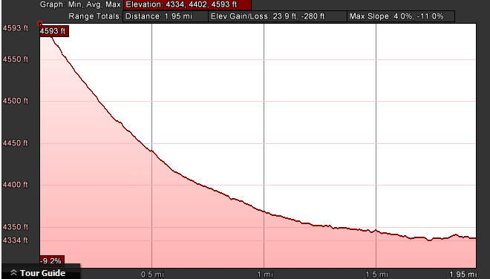
Elevation Change Mark Twain to HWY 50
Elevation difference of 280 ft
180 ft to water in Mark Twain Estates
Mark Twain Estates average well depth 270 feet
HWY 50
Estimated groundwater table

Slide 12
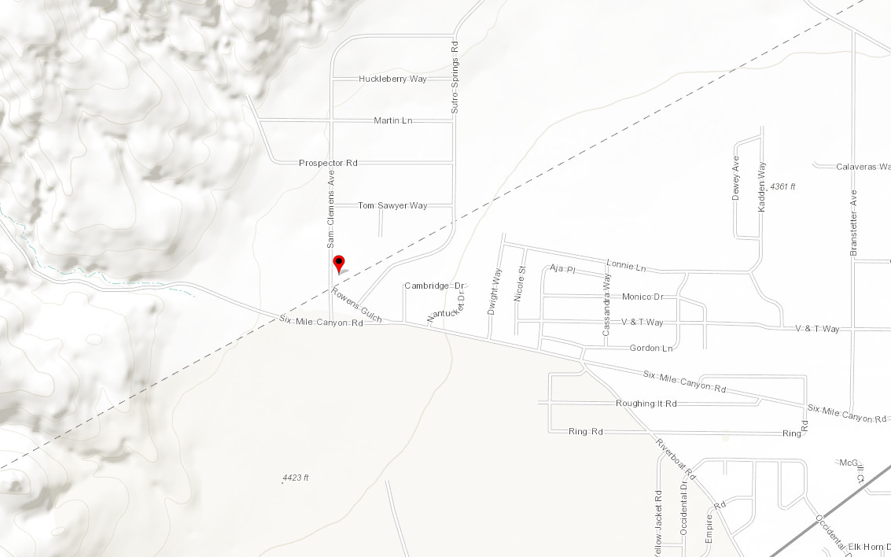
GW Monitoring near Mark Twain Estates
Mark Twain Community Center

Slide 13
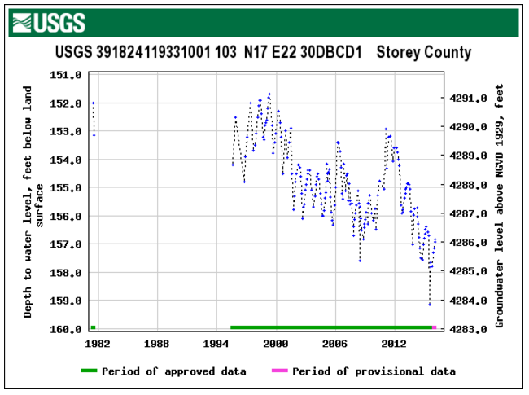
Drought Impacts 2012-2016

Slide 14
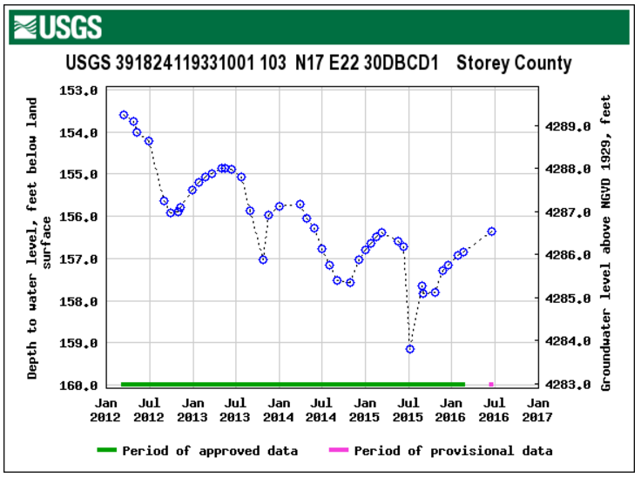
Drought Impacts 2012-2016
~3.0 ft decline

Slide 15
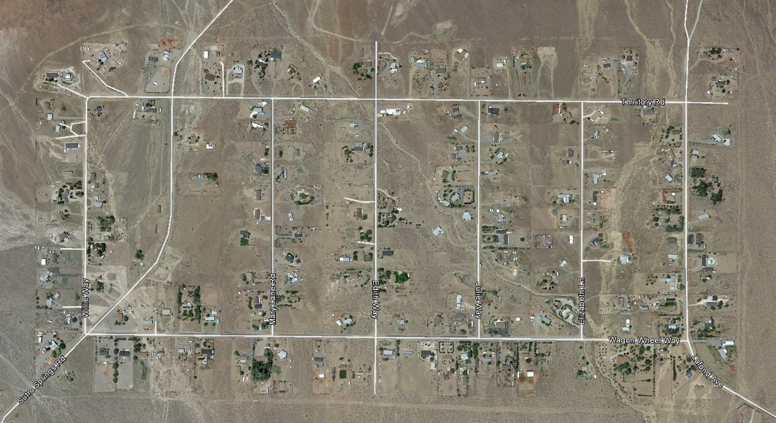
Revised Monitoring Plan for Mark Twain
Target 7-8 domestic wells for monthly monitoring
Deploy 1 continuous pressure transducer (potentially need more)
USGS Site
Proposed Site

Slide 16
Revised Monitoring Plan for Mark Twain
Data from current monitoring well
Monitoring Well
WWW

Slide 17
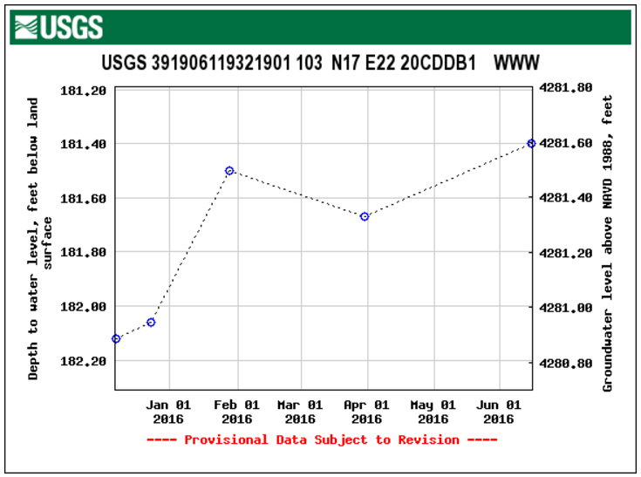
Mark Twain Water-level Monitoring
Notes:
Water-level has increased during the monitoring period

Slide 18
Mark Twain Subdivision Monitoring
Target 7-8 domestic wells for monthly monitoring
Deploy 1 continuous pressure transducer (potentially need more)
Monitoring Well

Slide 19
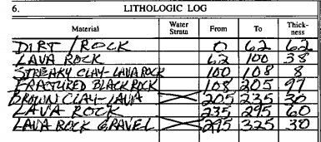
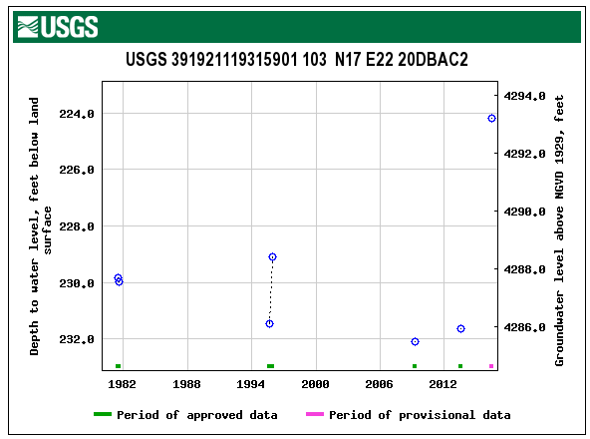
Separate Aquifers?
Total well depth 325 feet
Separated by brown clay layer at 205-235 ft below land surface
Water-level has declined only 2 ft since 1982
Several feet of recovery observed with most recent measurement

Slide 20
Mark Twain Subdivision Monitoring
Nevada Division of Water Resources Well Database used to identify wells that have been deepened or re-drilled
Location of well deepened in 2015
However, water-level stable at 182 feet (5 measurements)
Well Deepened on 10/22/15
Notes:
Locally heavy use may effect local water-level conditions in nearby domestic wells

Slide 21
Results Mark Twain Monitoring
Well logs indicate potentially multiple aquifers in the area
  Clay layers between 120-225 ft bls of varying thickness
  Deep wells completed in fractured Andesite layer >200 ft bls
Are water-level fluctuations and dry wells isolated to one aquifer and in one area?
Locally heavy domestic use could potentially result in water level declines in nearby domestic wells. (Isolated area)

Slide 22
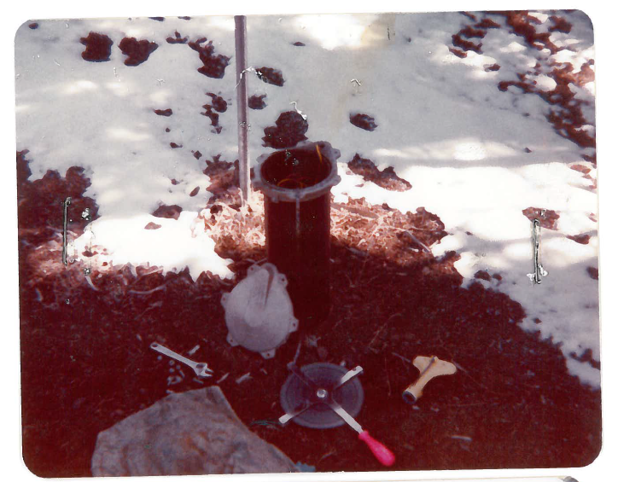
Water-level conditions in VC Highlands
USGS currently monitors two wells in the VC Highlands
  Annual frequency for Nevada Division of Water-Resources
Water-level declines noticed during a recent review of data.

Slide 23
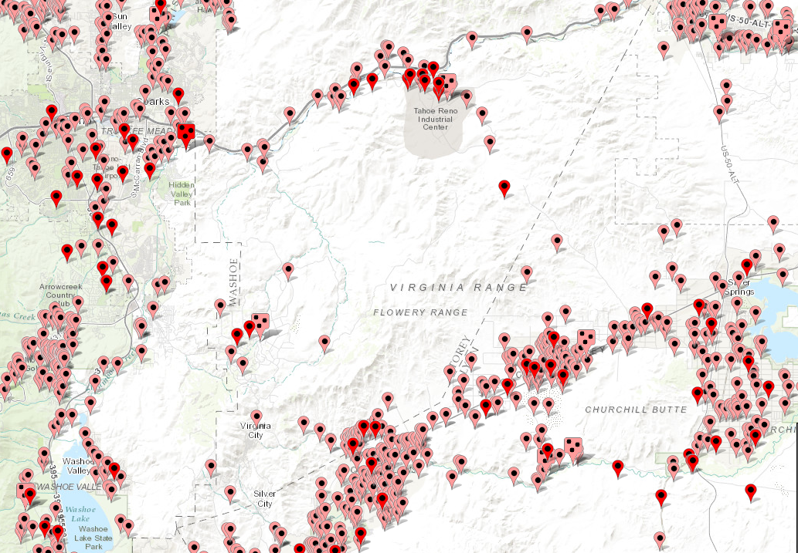
http://maps.waterdata.usgs.gov/mapper/index.html
VC Highlands
Notes:
Map details the location of USGS groundwater sites. Active sites (dark red pins) represent locations where data has been collected within the past year. Inactive sties (pink pins) have data collected at some point in the historical record.

Slide 24
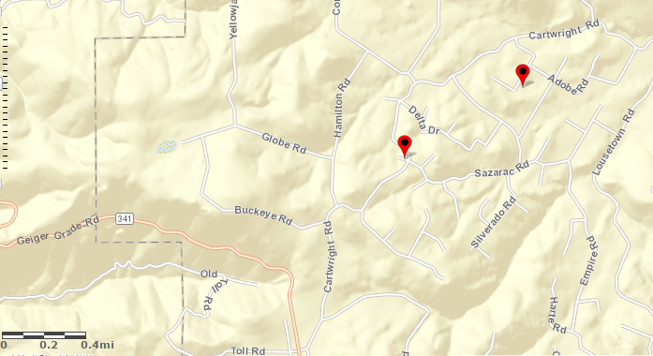
USGS Monitoring Wells in VC Highlands
32ABCD1
32CBBD1

Slide 25
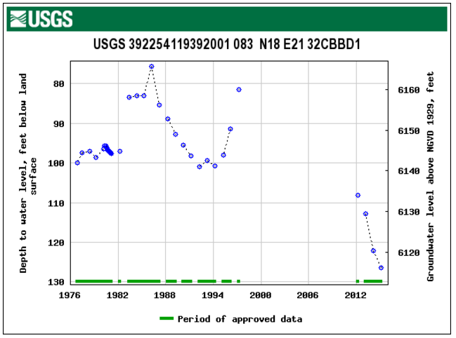
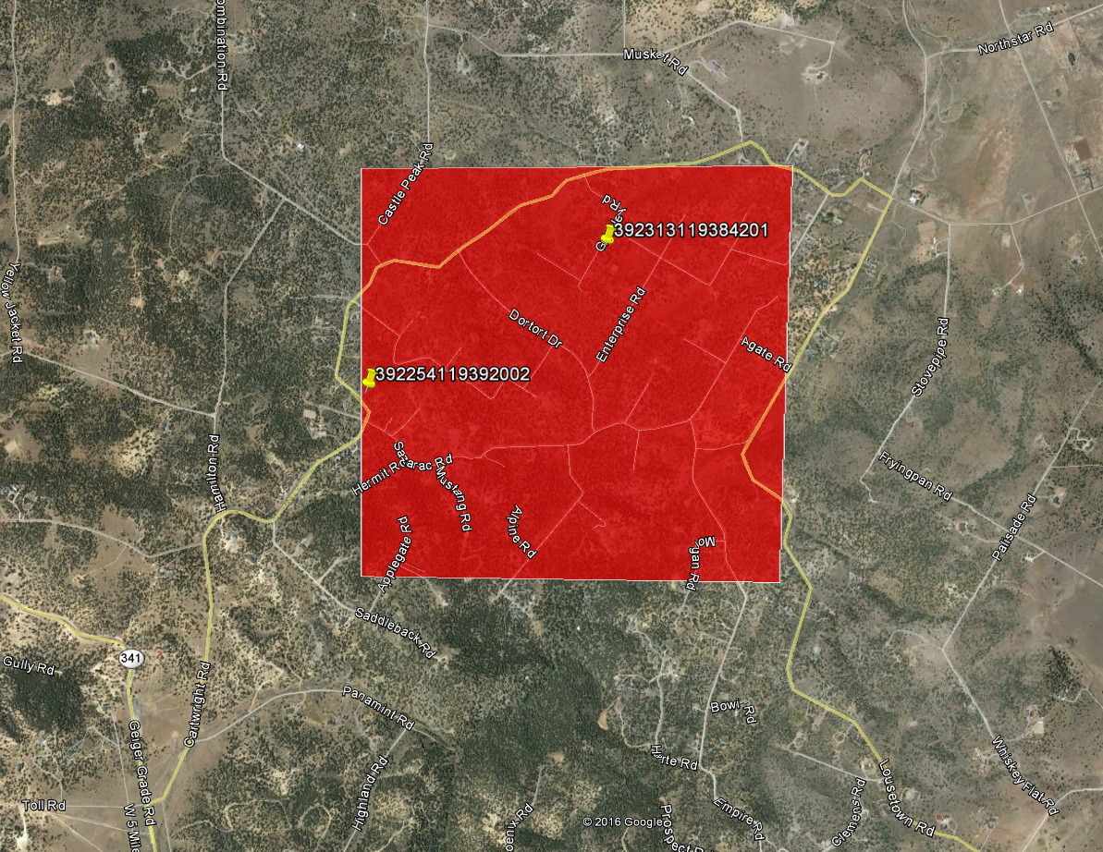
USGS Annual Well Locations
1997 to 2016
Decline of 50’
Well Re-drilled in 2015
Notes:
Water levels can recover by 10's of feet during most extreme wet years like 1983, 1995, and 1997.
However, recharge events are too infrequent too balance the observed declines.

Slide 26
USGS Monitoring Wells in VC Highlands
32ABCD1
32CBBD1

Slide 27
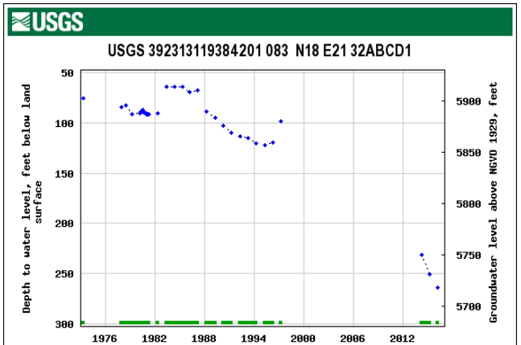
USGS Annual Well Locations
1997 to 2016
Decline of 165’
Are wells being re-drilled in areas of water-level decline?

Slide 28
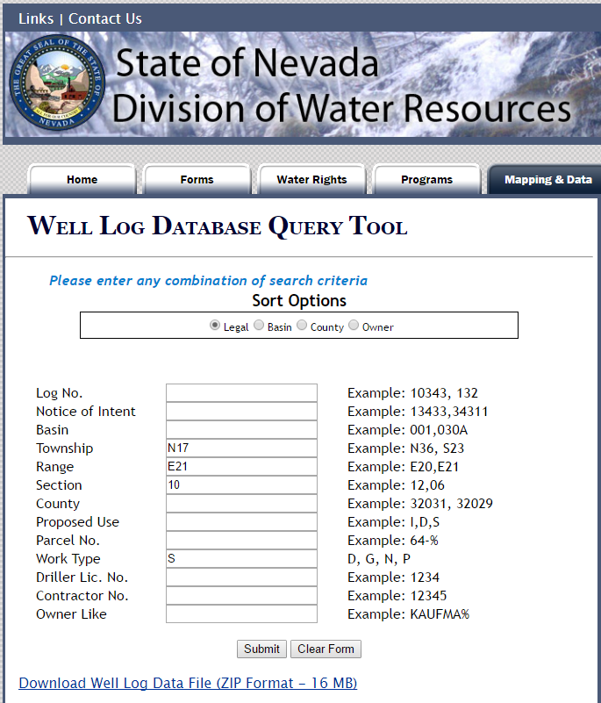
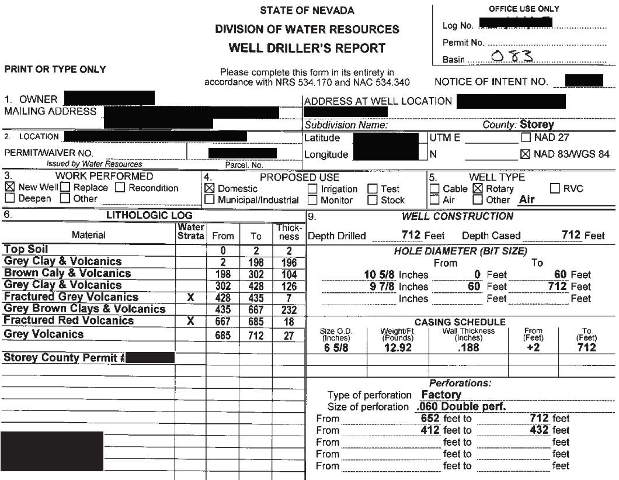
Nevada Division of Water Resources Well Database, Virginia City Highlands
State Database http://water.nv.gov/data/welllog/
  Store well logs, type of well (replacement/deepened)
  Data from 1960 - Current Year
  Wells filed by township/range/section

Slide 29
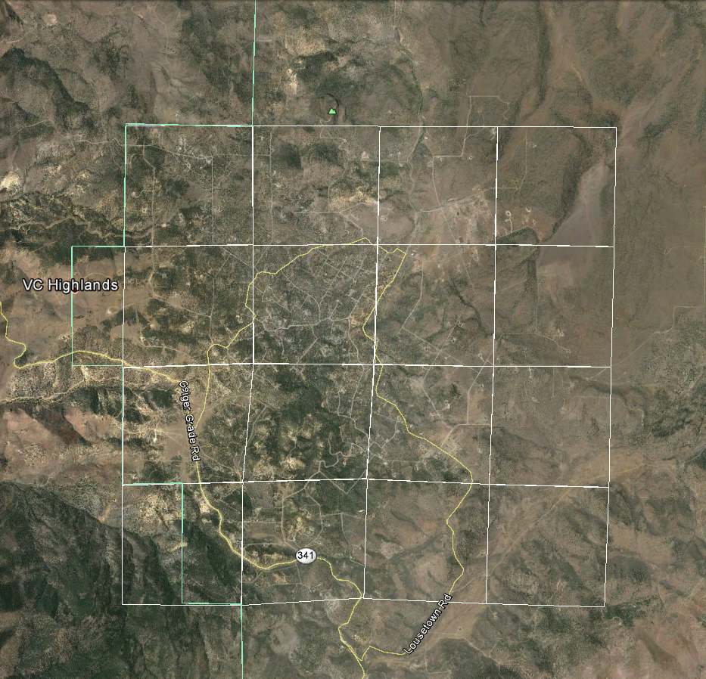
Sections

Slide 30
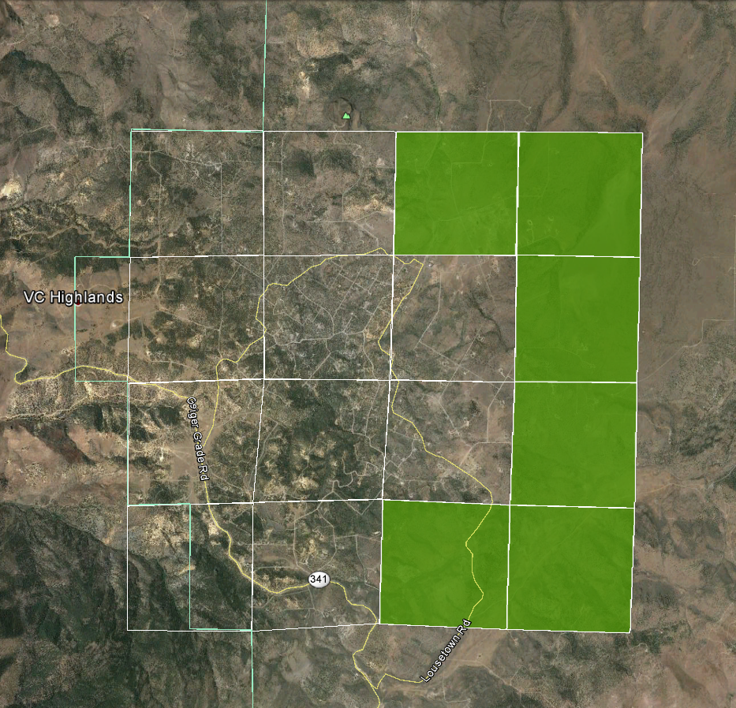
25 Wells,
0 Replaced, (or deepened)
0%
7 Wells
0 Replaced
0%
Wells represent
total number of
wells in section
Replaced is
replaced or
deepened wells
in section
9 Wells
0 Replaced
0%
7 Wells
0 Replaced
0%
3 Wells
0 Replaced
0%
2 Wells
0 Replaced
0%
Notes:
“Wells” represents the total number of wells in the section
“Replaced” is the combined total of deepened and replaced wells. A secondary well is only drilled if an attempt to deepen the well has failed.

Slide 31
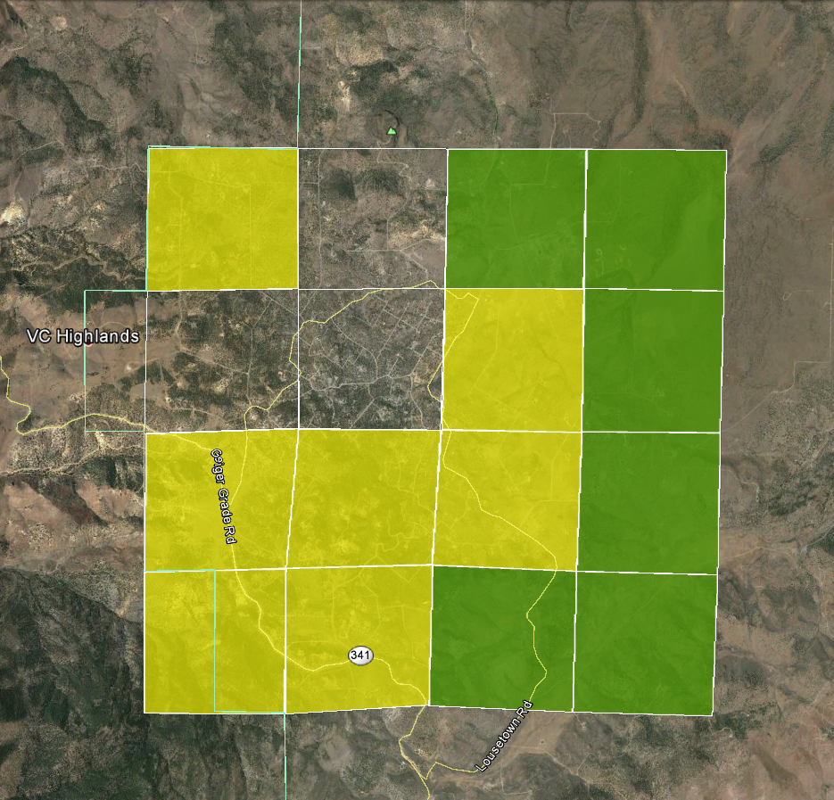
34 Wells
4 Replaced
12%
25 Wells
0 Replaced
0%
7 Wells
0 Replaced
0%
37 Wells
5 Replaced
14%
9 Wells
0 Replaced
0%
34 Wells
4 Replaced
12%
79 Wells
9 Replaced
11%
57 Wells
4 Replaced
7%
7 Wells
0 Replaced
0%
15 Wells
2 Replaced
12%
42 Wells
3 Replaced
7%
3 Wells
0 Replaced
0%
2 Wells
0 Replaced
0%

Slide 32
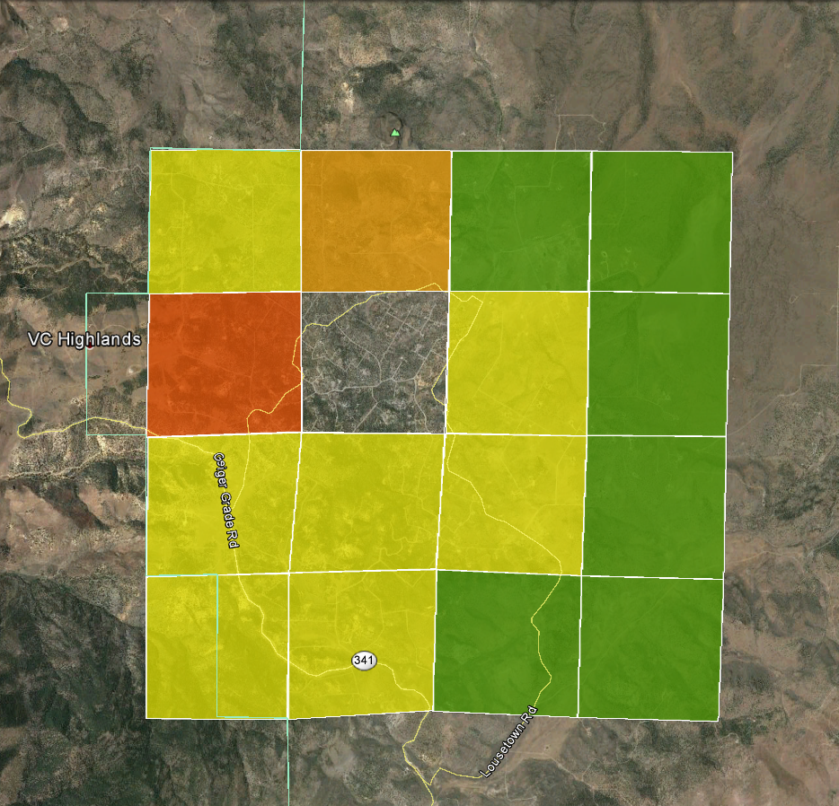
34 Wells
4 Replaced
12%
25 Wells
4 Replaced
16%
25 Wells
0 Replaced
0%
7 Wells
0 Replaced
0%
53 Wells
12 Replaced
23%
37 Wells
5 Replaced
14%
9 Wells
0 Replaced
0%
34 Wells
4 Replaced
12%
79 Wells
9 Replaced
11%
57 Wells
4 Replaced
7%
7 Wells
0 Replaced
0%
15 Wells
2 Replaced
12%
42 Wells
3 Replaced
7%
3 Wells
0 Replaced
0%
2 Wells
0 Replaced
0%

Slide 33
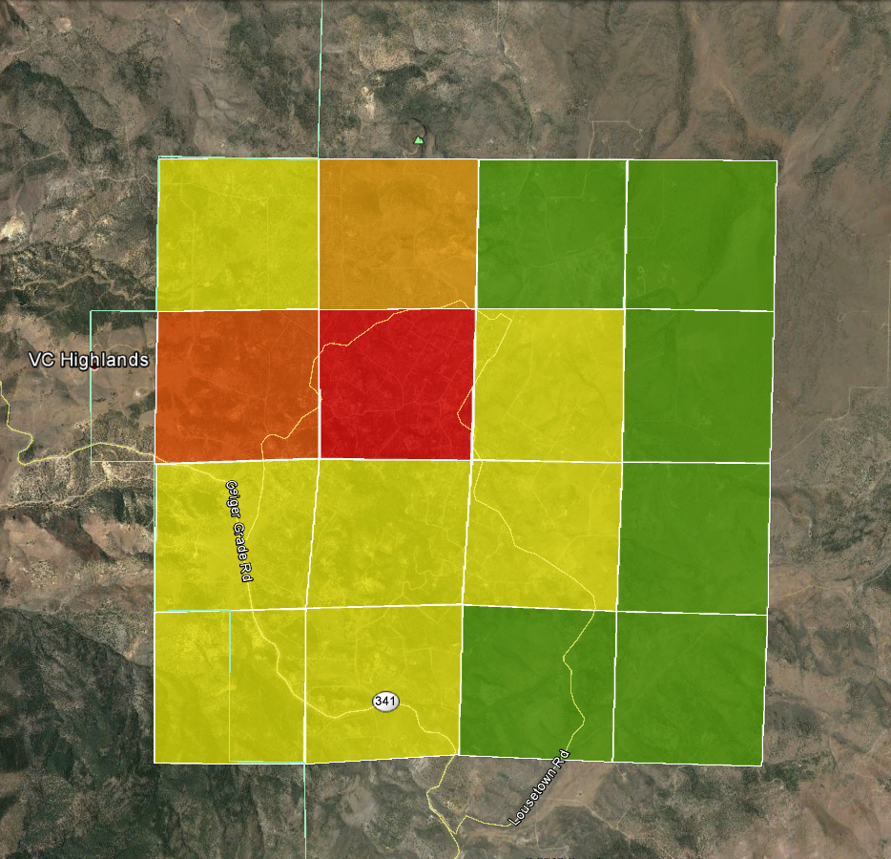
34 Wells
4 Replaced
12%
25 Wells
4 Replaced
16%
25 Wells
0 Replaced
0%
7 Wells
0 Replaced
0%
53 Wells
12 Replaced
23%
194 Wells
50 Replaced
28%
37 Wells
5 Replaced
14%
9 Wells
0 Replaced
0%
34 Wells
4 Replaced
12%
79 Wells
9 Replaced
11%
57 Wells
4 Replaced
7%
7 Wells
0 Replaced
0%
2 USGS monitoring wells shown earlier are in this Section
15 Wells
2 Replaced
12%
42 Wells
3 Replaced
7%
3 Wells
0 Replaced
0%
2 Wells
0 Replaced
0%

Slide 34
Fractured
Volcanic
Aquifers
Notes:
Well Driller’s report in the VC highlands indicate that wells are screened, or completed, in fractured volcanic aquifers.

Slide 35
Conclusions: State Well Log Database
Groundwater Wells in VC Highlands – ~623
Wells either deepened or replaced – ~103 or ~16%
Limited Groundwater Level Measurements
  1997 used as reference date
 | Number of Wells | Mean Depth (ft) | Redrilled Wells
Before 1997 | 311 | 225 | 16
After 1997 | 312 | *375 | 87
*assuming $50-100 per/ft drillers fee, represents an estimated cost of $7.5k-15k to homeowner

Slide 36
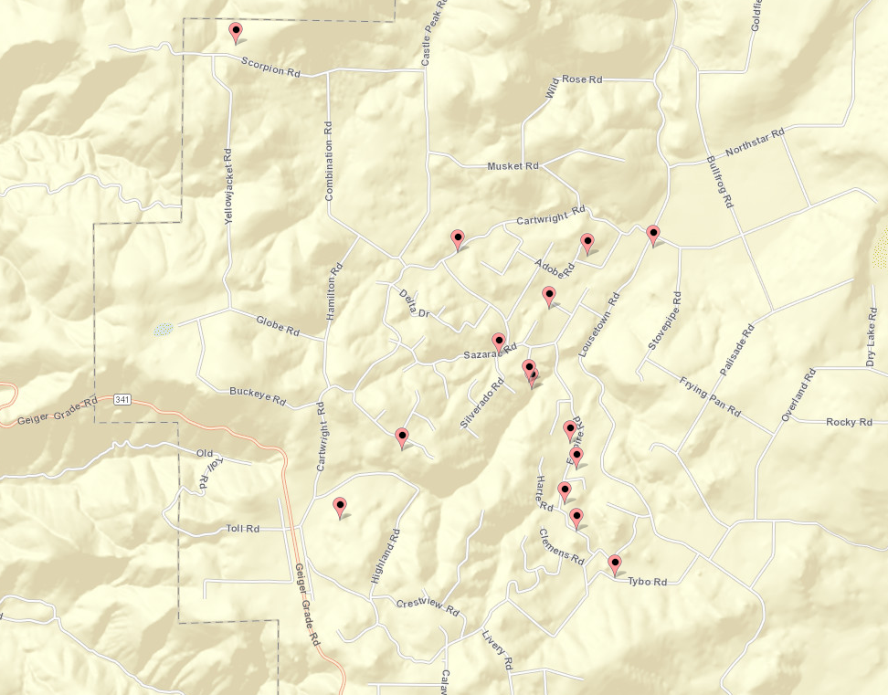
USGS Water Quality
Water-Quality sampling
between 1972-1975
  21 wells were sampled for
  limited analysis
Arsenic average 2.8 ppb (EPA MCL is 10 ppb)
Nitrate average 0.11ppm (EPA MCL is 10 ppm)
Chloride average 9.0 ppm (EPA recommends <250 ppm)
Total Dissolved Solids (TDS) 867ppm (EPA recommends <1000 ppm)
High levels of Iron associated with shallow wells >0.3 ppm

Slide 37
Summary
Preliminary findings in the Mark Twain area
  Water levels appear to be stable (early in monitoring period though)
  Evidence of substantial water level declines not observed
  Localized water level declines could be present
VC Highlands
  Water-level decline is real and causing deepening
    and re-drilling of wells
  Extent of declines is not well
  characterized
  Historical water quality is available
  as a baseline reference for
  characterizing future change

Slide 39
Where do we go from here?
Current data is limited; difficult to fully understand the problem
Additional monitoring to identify water-level trends
  Identify conditions of groundwater recharge and depletion from pumping
Identify and characterize aquifers
  What is the extent of declines in VC Highlands?
Is water-quality changing?
  With declining water levels?
  With time?
  Some historical measurements are available for comparison

